Slide 1

Hacking Wifi Using a Samsung Smart Fridge
By: Dennis Freyman

Slide 2
Identifying the Target & Vulnerable Services
Understanding the Exposure:
The Vulnerability
Many IoT devices, including smart fridges, have remote control features that allow users to control them over network. These devices communicate with external servers. Samsung uses an operating system called Tizen OS. It runs a web server for local administration and it often lacks strong authentication mechanisms.
The attacker would search for a Samsung fridge running a vulnerable firmware version using the CVE-17562 vulnerability. This vulnerability involves improper authentication checks, allowing for remote code execution (RCE).
If the fridge’s HTTP service is exposed without requiring authentication or using outdated encryption (e.g., no HTTPS), the attacker can exploit the web server.

Slide 3

Scanning with Shodan
Using Shodan, a search engine for internet-connected devices, which allows attackers to identify exposed IoT devices, the attacker can perform a scan. In this case, you’d use it to find smart fridges running outdated Tizen OS (most) that may have been left exposed on the internet. Search Query Example: "port:80 Samsung Tizen OS" After identifying a potential target, an attacker would use nmap to perform a more detailed scan on the IP address to detect open ports and services.

Slide 4


Exploiting the Vulnerability to Inject Malicious Code
Now that the target smart fridge is identified, the next step is to inject malicious code via the fridge's update system, even without being on the same Wi-Fi network. Here's how that could theoretically happen:

Slide 5

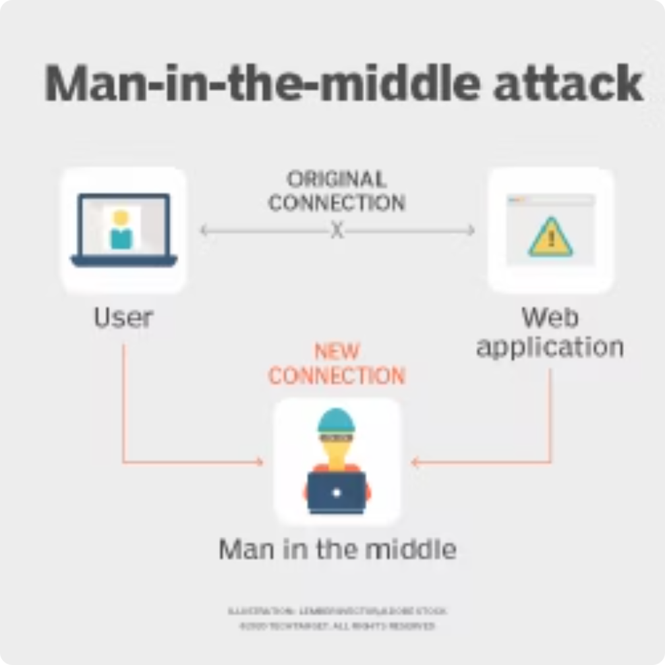
Step 2.1: The Firmware Update System:
Exploiting the Fridge
MITM
Samsung smart fridges automatically check for firmware updates by contacting Samsung's cloud servers. This communication is often done over HTTP or HTTPS.
In some cases, devices are susceptible to man-in-the-middle (MITM) attacks or update hijacking if the device doesn't properly verify the authenticity of the update source.

Slide 6

Step 2.2: Man-in-the-Middle Attack
DNS Spoofing/Poisoning:
A DNS query (also known as a DNS request) is a demand for information sent from a device (DNS client) to a DNS server. In this case, the fridge is sending a DNS request to the server asking for the address from where it should update from.
DNS cache poisoning typically works against DNS resolvers that do not have strong protections. For example: older or misconfigured DNS servers often use predictable source ports for DNS queries, making it easier to spoof responses. The first step is to break into one of these DNS servers (seperate presentation) and monitor the traffic from the fridge.

Slide 7



Poisoning the Update
Forge the Fake DNS response
Tools
New Server!
The attacker needs to match certain details in the DNS response to make it look legitimate (this is not yet an attack):
DNS Spoofing Tools: Tools like DNSChef or dnsspoof can be used to forge and send these malicious DNS responses DNSChef allows you to create custom DNS responses based on a set of rules and configurations, redirecting traffic to a malicious server or a custom IP address.
Once the forged DNS response is accepted by the fridge (or the DNS server it uses), the incorrect IP address is cached for future requests. This means that:
Transaction ID:
Port Number
When the fridge tries to contact update.samsung.com for its firmware update, it will connect to the attacker's server instead of the legitimate Samsung server.
Response Time: The attacker’s forged response needs to reach the device before the legitimate DNS response. This is a race against time.

Slide 8




Setting Up the Malicious Update Server
Why
Now that the smart fridge is pointing to the attacker’s server for firmware updates, the attacker needs to host a malicious server that mimics the legitimate update process.
Server Setup
The attacker sets up a server that looks like Samsung’s official update server. The server provides a malicious firmware update package containing a backdoor or other exploit that gives the attacker control of the fridge’s operating system.
Fake Firmware
Fake Update Process: The fridge requests the update package from update.samsung.com, but since the DNS cache is poisoned, it reaches the attacker's server, which provides the compromised firmware file.

Slide 9

Step 2.3: Inside the Fridge
Once the malicious firmware is installed, the attacker now has remote access to the smart fridge without ever needing to be on the same Wi-Fi network due to the backdoor that was installed during the firmware update.
Through this backdoor, the attacker can remotely access the fridge and gain administrator level access to the fridge, allowing access to the full system remotely.

Slide 10

Step 2.4: Extracting Wi-Fi Credentials
1
1. Access Configuration Files
The attacker accesses the fridge’s memory where Wi-Fi credentials are stored.
2
2. Plaintext
In most IoT devices, Wi-Fi credentials are saved in plaintext or in weakly encrypted files to maintain persistent connectivity.
3
3. Shell
Using shell commands, the attacker navigates the file system and dumps the contents of files like /etc/network/wifi.conf, which contains the SSID and Wi-Fi password.
4
4. Decryption (sometimes)
Decrypting: If the Wi-Fi credentials are encrypted (though weakly), the attacker decrypts them using known vulnerabilities in the encryption implementation of older Tizen versions.

Slide 11



Hacking the Wifi
Connecting to the Wi-Fi Network
Scanning the Network
With the extracted Wi-Fi credentials, the attacker can now connect directly to the target Wi-Fi network from any device within range, just as any legitimate user would. Once on the network, the attacker can see all devices connected to the same Wi-Fi network. They are now effectively inside the local network and can start reconnaissance.
Using a Tool like nmap or Zenmap (GUI of nmap) the attacker can scan the network and list all devices connected to the Wi-Fi. The attacker can run commands to identify IP addresses and open ports of devices on the network.
Afterwards, using OpenVAS or Metasploit the attacker can scan for vulnerabilities in the devices connected to the network. Vulnerabilities such as open ports, outdated software versions, weak passwords, or unpatched firmware then become targets for further attacks.

Slide 12

Attacking Other Devices on the Network
1. The Goal
2. Brute Force
The ultimate goal is to take over the router, which controls the Wi-Fi network. Many routers have weak default passwords (e.g., "admin" or "password"), especially if the router has not been secured by the owner.
Use Hydra or Medusa (brute force attack tools) to perform a brute-force attack on the router’s admin login page. If the router is using default credentials or weak passwords, the attacker can gain full administrative control.
3. Controlling the Router
Once inside the router's admin panel, the attacker can
-Change DNS Settings: Redirect all devices on the network to malicious websites by changing the router's DNS settings (e.g., pointing to malicious DNS servers).
-Kick Devices Off the Network: Disconnect legitimate users by deauthenticating devices from the network or by changing the Wi-Fi password, locking out legitimate users while maintaining control.

Slide 13



More Possibility
MITM Attacks on Network Traffic
Exploiting Network Devices
Network-wide Denial of Service (DoS) Attack
The attacker can now push malware to unprotected or vulnerable devices on the network. The attacker can then install ransomware to lock the user out of their system until a ransom is paid and take control of smart home systems, like cameras, locks, or thermostats, to spy on users or disable security features.
Using Ettercap or Wireshark the attacker can perform packet sniffing and intercept traffic between devices on the network. The attacker can now capture sensitive information such as Login credentials and session cookies, allowing the attacker to hijack authenticated sessions.
As a final measure, the attacker can completely disrupt the Wi-Fi network, locking out legitimate users and potentially damaging the devices connected to it. This can be done by launching a flood of network traffic at the router or specific device using tools like LOIC or hping3, which overload the device’s network resources, effectively taking it offline, causing chaos.

Slide 14

Mitigation
Regularly update IoT devices to prevent exploitation of known vulnerabilities.
Use strong, unique Wi-Fi passwords and implement WPA3 encryption.
Segment IoT devices on a separate network or VLAN to limit access to critical systems.
Secure the router with a strong password and disable unnecessary remote management features.

Slide 15

Join Groupme

